Slide 1

WEBSITE

Slide 2
Sinhgad Institute Of Business Administration And Research
Master’s of Computer Application
Sem-I Batch-I 2024-26
ITC11 Mini Project
“Project Title : E-Commerce Website”
BY Pratiksha Hegade Roll No:- 78
Under the Guidance Of “Prof. Snehal Dhane”

Slide 3
Roll Numbers and Names of Team members :-
Roll No Name
37 Dipali Nanavare
12 Ajay Supekar
78 Pratiksha Hegade
103 Shivraj Suryavanshi

Slide 4
Contents
Project Title
Scope of project
Existing System
Proposed System
Technologies used
List of modules
UML Diagrams

Slide 5
Introduction :-
E-Commerce, also known as electronic commerce or internet commerce, is an activity of buying and selling goods or services over the internet or open networks. So, E-commerce can be defined in many ways, some define E-Commerce as buying and selling goods and services over the Internet, others define E-Commerce as retail sales to consumers for which the transaction takes place on open networks. The buying and selling of products, services, and digital products through the Internet all comes under e-commerce.

Slide 6
Scope of project :-
The scope of this project is to develop an Ecommerce website that refers to the process of buying and selling products or services over the internet. It’s a form of business transaction that allows individuals and businesses to conduct commerce through an electronic platform , such as a website.
Ecommerce has change the way people shop, as it eliminates the need for physical visits to stores and allows customers to purchase goods from anywhere, at any time. It also enables businesses to reach a wider customer base, both domestically and internationally, by making their products or services available online.

Slide 7
Existing System :-
Many businesses still rely on physical stores or outdated e-commerce systems that lack customization, user experience, or mobile responsiveness. Some e-commerce solutions can be expensive or difficult to manage for small businesses..
Disadvantages:-
Limited Customization Options
Poor User Interface (UI) and User Experience (UX)
Lack of Mobile Responsiveness
High Maintenance and Operational Costs
Security Concerns

Slide 8
Proposed System:-
Our proposed solution for the e-commerce website project revolves around a holistic approach aimed at overcoming existing challenges and optimizing user experience. Key elements of our solution include:
Smooth User Experience
Efficient Backend Management
User Friendly Interface
Secure Transaction Processing
By focusing on these core aspects, our proposed solution aims to establish the e-commerce website as a leading destination for online shopping, catering to the diverse needs and preferences of modern consumers while providing businesses with a robust platform for growth and success.

Slide 9
Other Important Points:
Security Features: SSL encryption, secure payment gateways, and user authentication.
Mobile Responsiveness: The website will be fully responsive to ensure usability across all devices.
Analytics & Reporting: The admin dashboard will feature sales analytics, product performance, and customer insights.
Future Enhancements: Features like wish lists, customer reviews, recommendation engines, and AI chatbots could be integrated to enhance the system.

Slide 10
Technologies used:-
Frontend | Backend
HTML , CSS , Javascript, Bootstrap. | Python , Django.

Slide 11
List of Modules:-
1.User Authentication Module:-
User registration and login
User Profile Management
Password recovery/reset functionality
2. Product Management Module:
Product listing (display products with images, descriptions, and prices)
Product detail view
Categories and tags for organizing products
3.Shopping Cart Module:-
Add, update, and remove products in the cart
View cart summary
Calculate total price including shipping and taxes

Slide 12
4. Checkout Module:-
Order placement
Address management (billing/shipping addresses)
Payment processing (you can use a payment gateway like Stripe or PayPal)
5. Order Management Module:-
View past orders
Order status tracking
Order cancellation and returns
6. Admin Dashboard Module:-
Product management (add, edit, delete products)
Order management (view and update order status)
User management (view and manage user accounts)

Slide 13
7. Frontend Templates:-
Basic templates for all pages (homepage, product listing, product detail, cart, checkout, etc.)
Use Bootstrap or another CSS framework for responsive design.
8. Search Functionality (optional):-
Implement basic search for products based on name or category..
9. Reviews and Ratings (optional):-
Allow users to leave reviews and ratings for product
10. Report Generation:-
Generating the report of bill, sales, purchase

Slide 14
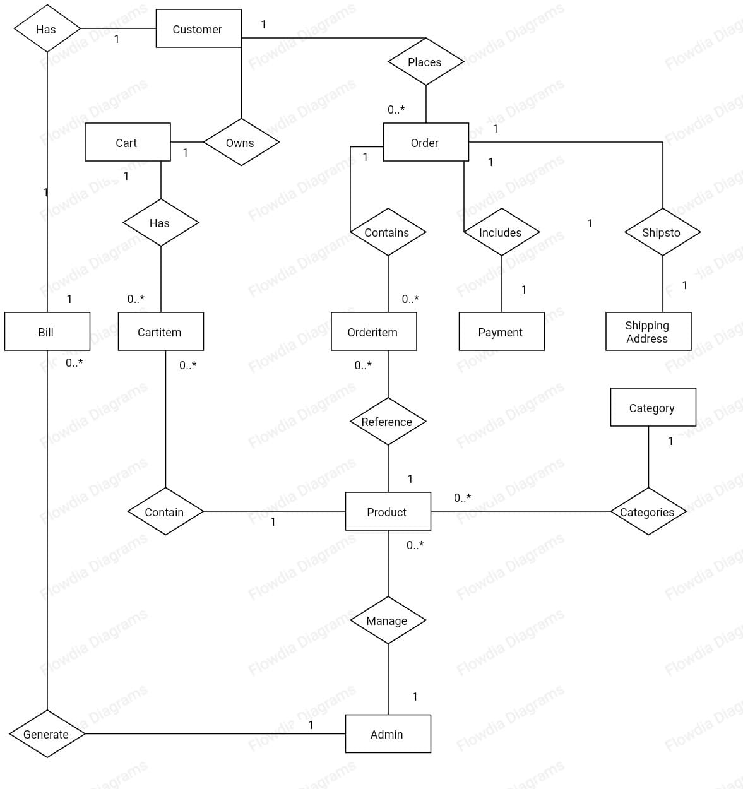
ER Diagram

Slide 15
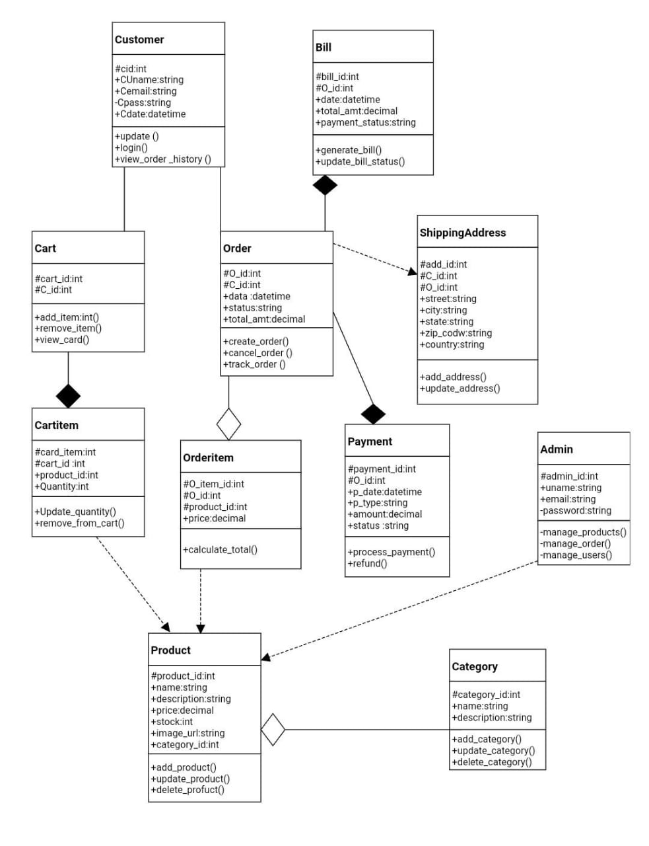
Class Diagram

Slide 16
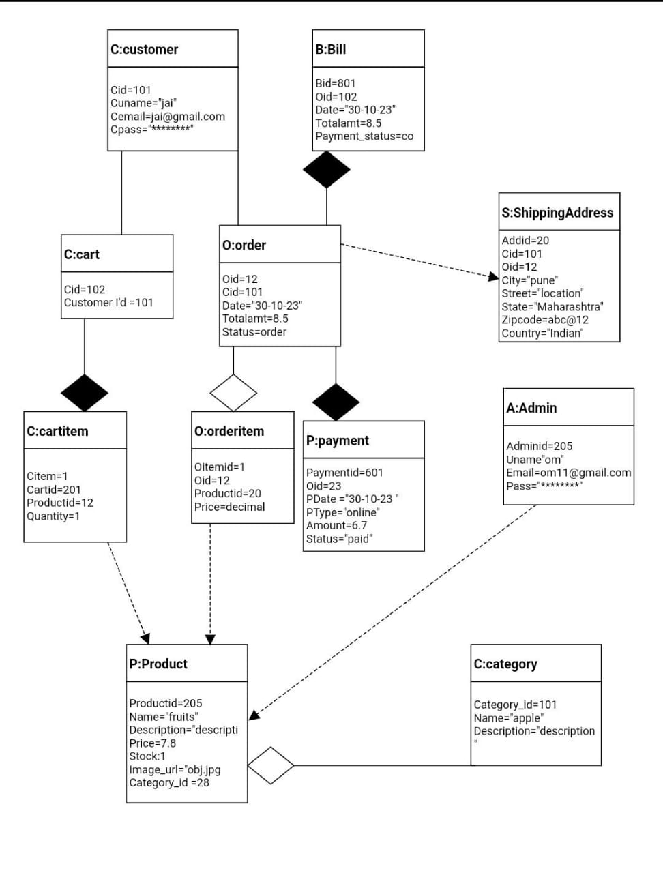
Object Diagram

Slide 17
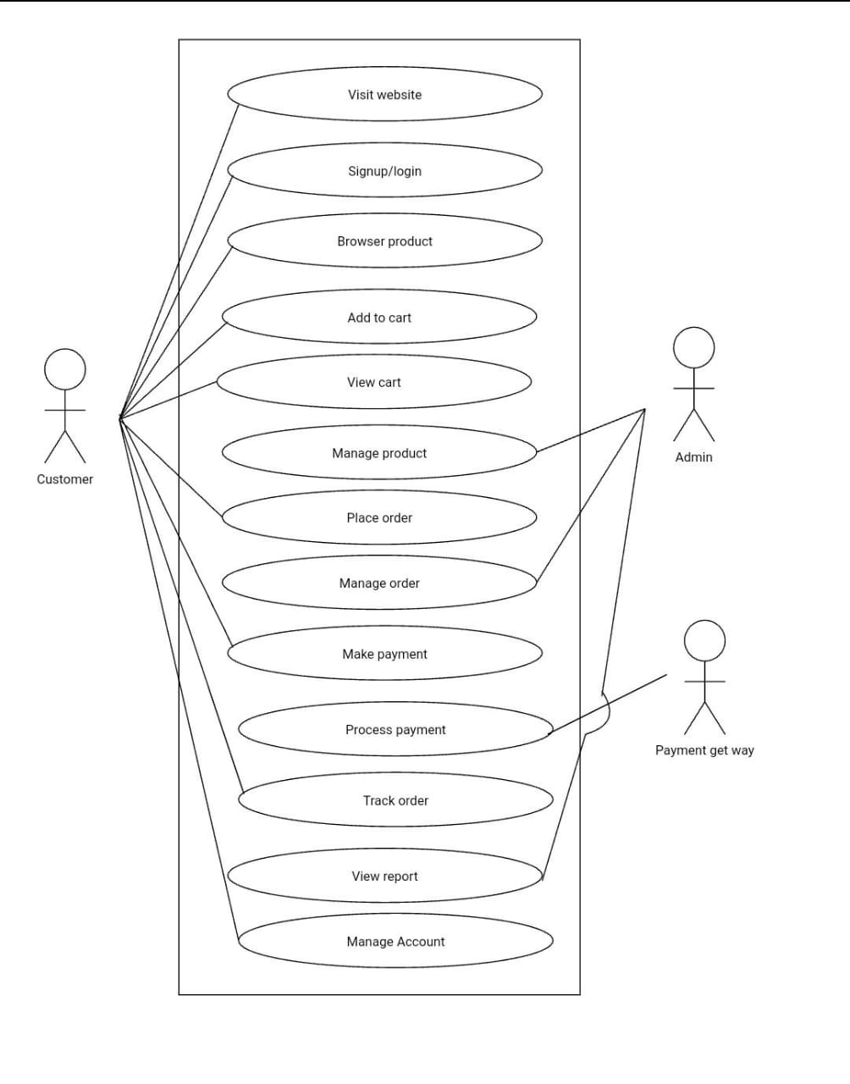
Usecase Diagram

Slide 18
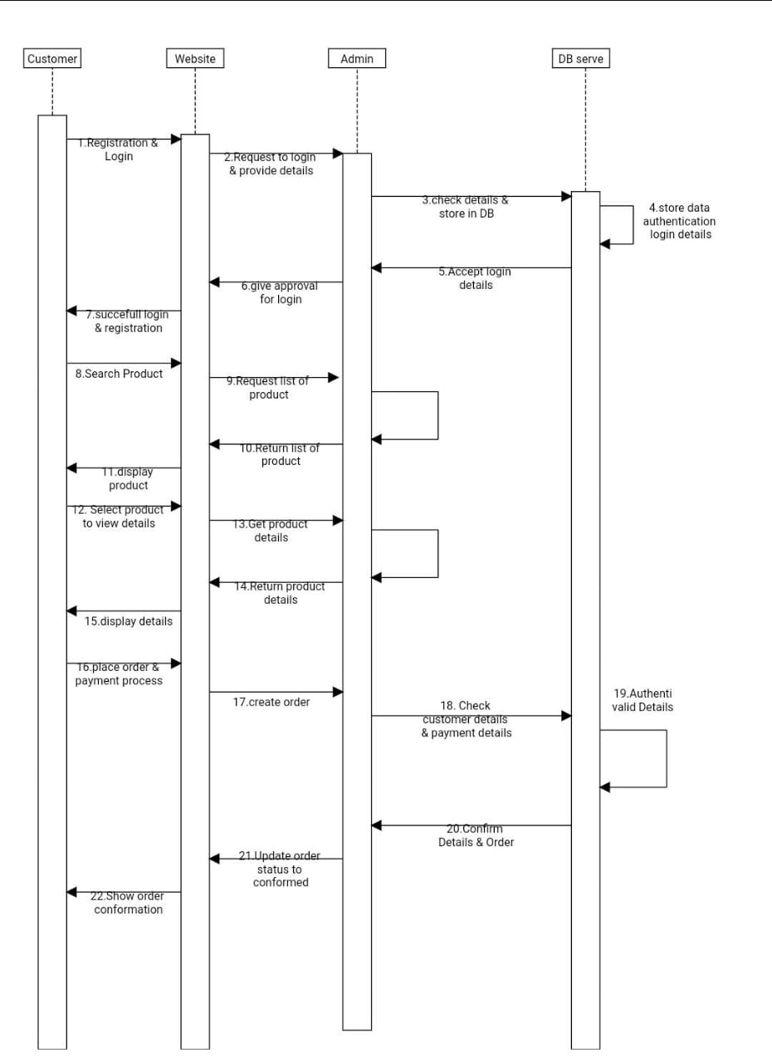
Sequence Diagram

Slide 19
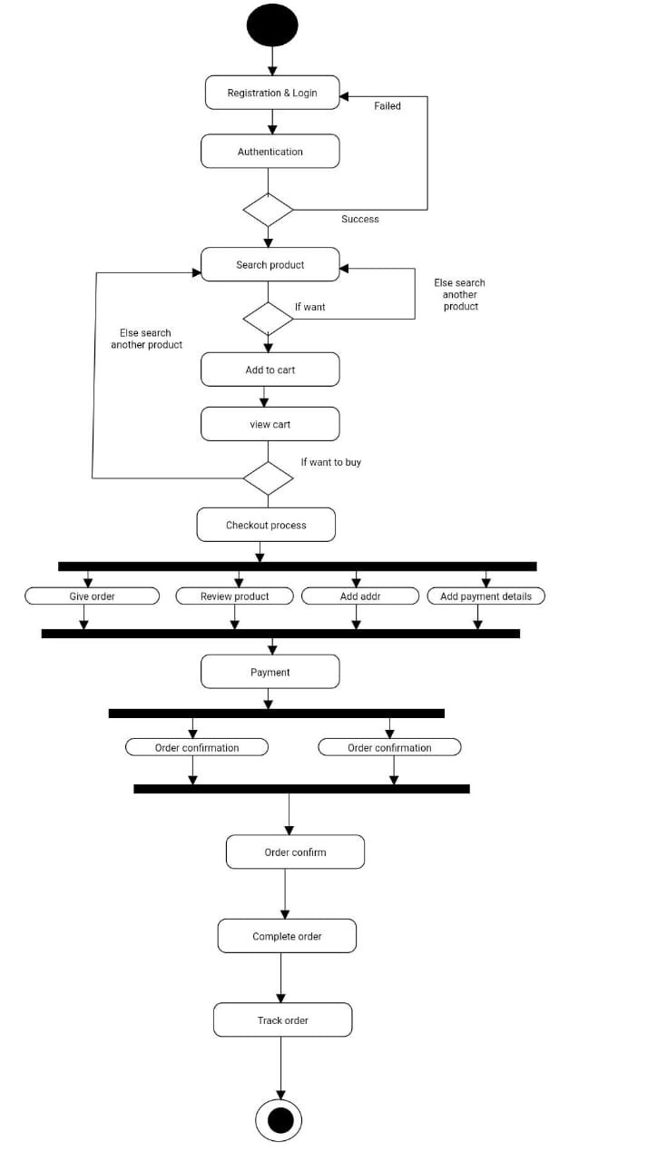
Activity Diagram

Slide 20
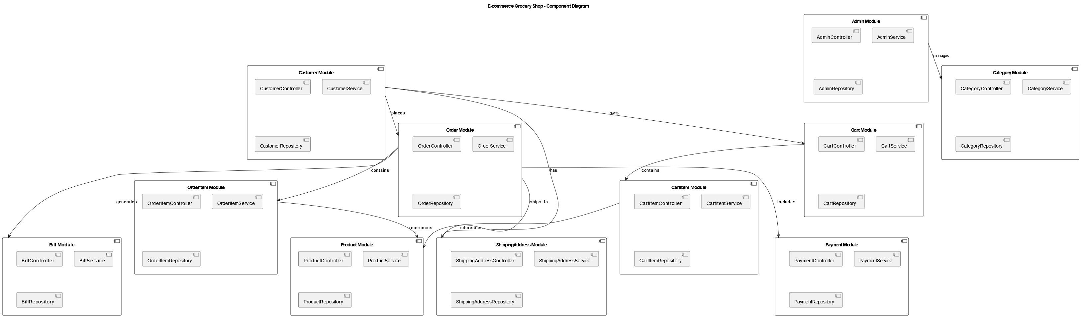
Component Diagram

Slide 21
Thank You…..

